Slide 1
_Esophagus
It is straight tube a25 cm long, it is continuous above with the pharynx and below with the cardiac of the stomach.
-The histological composition of the esophagus can be describe by the following:
•the lumen is lined by an epithelium, which is thick in human and consists of stratified squamous non-keratinized, continuous with the similar epithelium of or pharynx, ending sharply at the gastric junction, the striated squamous epithelium is replaced by simple columnar epithelium in the stomach.
•the lamina propria in turn surrounded by a narrow band of smooth muscle, which consist of longitudinally arranged smooth muscle in fine elastic network, sometime circularly arranged smooth muscle may be seen. In the empty esophagus the mucosa thrown in to several longitudinal folds

Slide 2
during passage of food bolus the esophagus dilates and extend and the folds disappears allow the lumen to increase in size.
•the sub mucosa beneath the mucosa we find a wide zone of loose connective tissue, which in addition to vessels and lymphatic, contain a nerve plexus(sub mucosal plexus or Meissner´s plexus), which is one of the two plexi innervating the alimentary canal.
The sub mucosa is surrounded by smooth muscle, which is typically divided in to two differenently oriented layers –an inner circular and an outer longitudinal layer, these layers of muscle are together referred to as the muscularis externa.

Slide 3
Between two muscle layers we find the second nerve plexus innervating the alimentary canal-myenteric plexus or Auerbach's plexus.
•the muscularis externa is somewhat usual in that it contains striated muscle in its upper one third, a mixure of striated muscle and smooth muscle in its middle one-third and smooth muscle in its lower one-third.
•the adventitia consists only of a layer of loose connective tissue ,only the lowest part of the esophagus enters the peritoneal cavity, a serosa forms the outermost part of the adventitia of this short intraperitoneal segment of the esophagus.

Slide 4
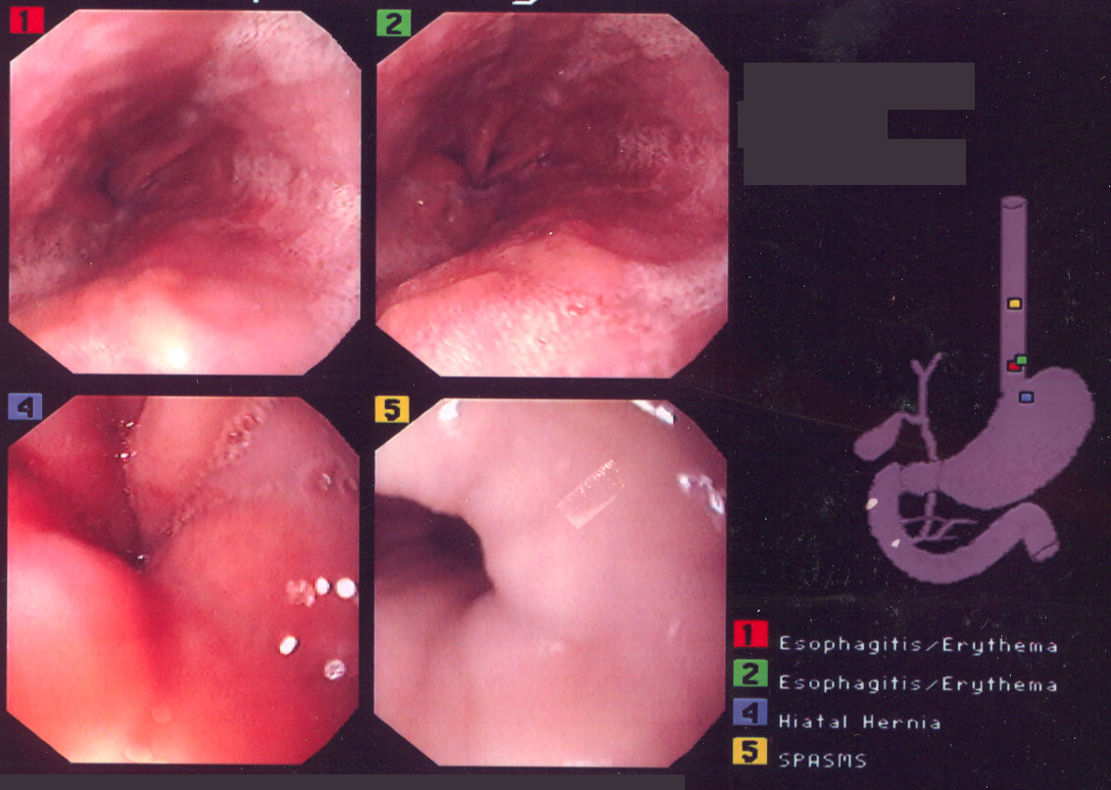
Endoscopic View of the Esophagus

Slide 5
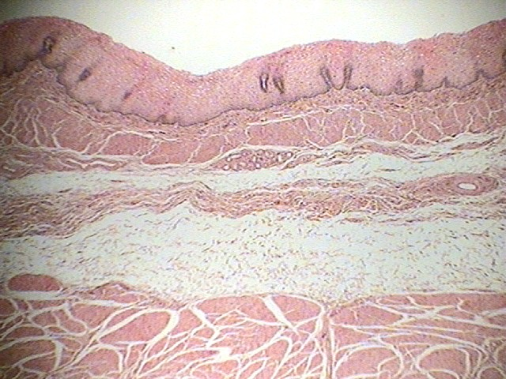
Microscopic View of the Esophagus

Slide 6
_Esophageal glands:
Glands may be present in one parts of the wall of the alimentary canal, these glands are called mucosal glands if they are located luminal(or superficial) to the muscularis mucosa.
If the glands extend in to the sub mucosa they are called submucosal glands.
Two kinds of glands are present in the esophagus:
_Esophageal cardiac glands
Two groups of these glands are present-one group located in the mucosa of proximal part of esophagus near the pharynx and the other in the distal part near the cardiac part of the stomach, both are branched tubular, alveolar glands secret mucus located in the lamina propria, protect the esophageal

Slide 7
Mucosa from acidic reflux from the stomach.
_Esophageal glands proper
Acidic mucous compound, tubulo-alveolar, and lying in the sub mucosa which lubricates the mucosa and help in the passage of food, less numerous, located in the middle segment of the esophagus.

